Slide 1
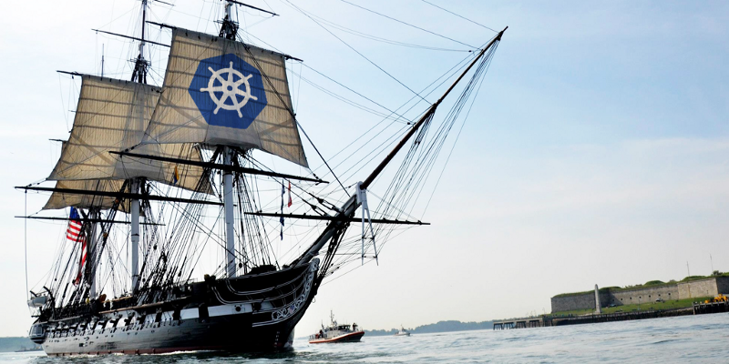
Using Kubernetes
Day 2
Nesia Amit

Slide 2
Agenda
Kubernetes Introduction
Kubernetes Introduction
Kubernetes Concepts
Deploy Multi Microservices

Slide 3
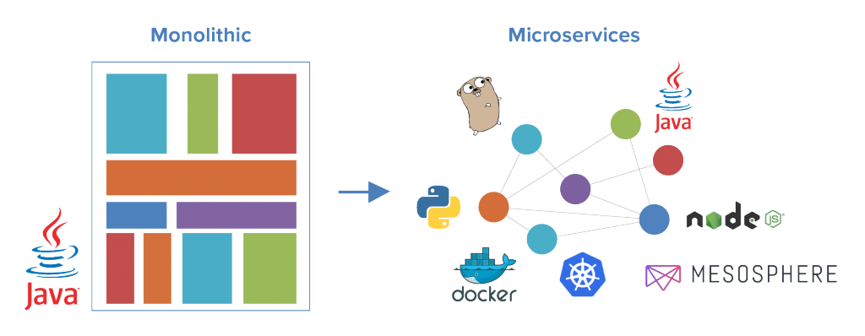
Monolith to Microservices Architecture

Slide 4
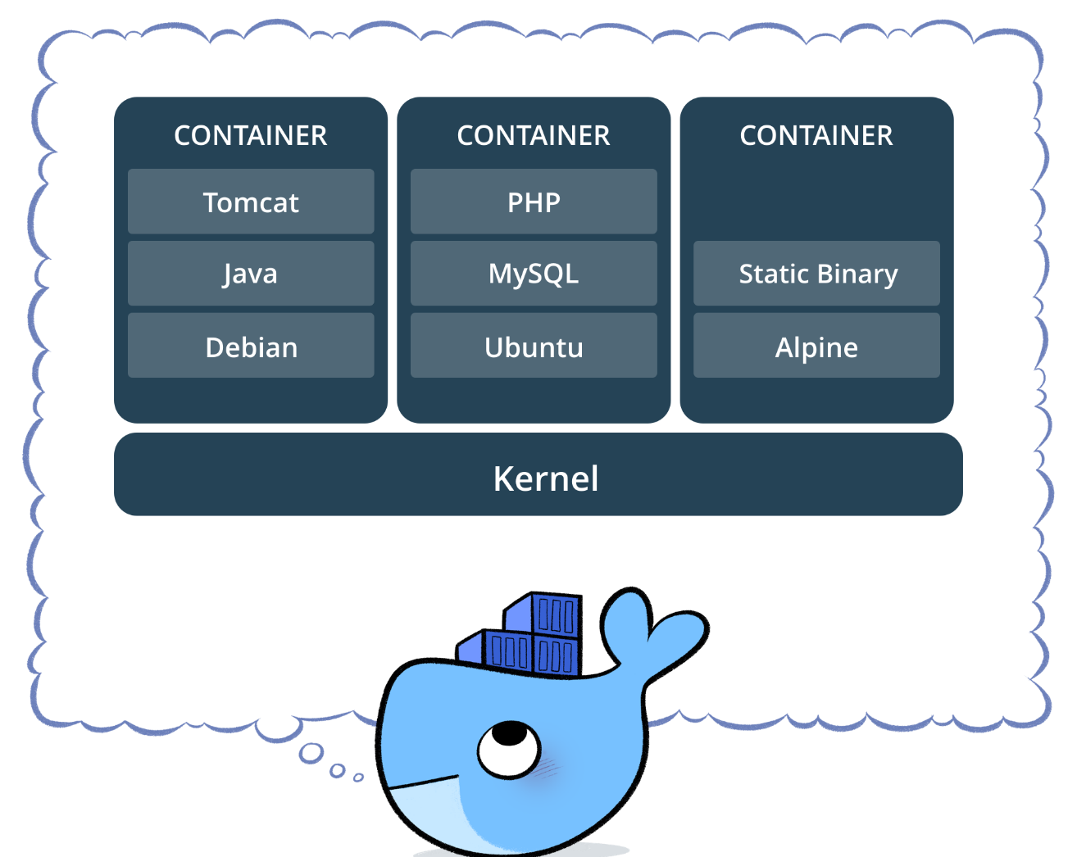
Containers (Docker or Rocket)
A container consists of an entire runtime environment: an application, plus all its dependencies, libraries and other binaries, and configuration files needed to run it, bundled into one package.

Slide 5
Technology to the rescue - Container Orchestration
The growing of microservices and the need to scale them introduced challenges like:
Auto Deploy our microservices quickly and predictably.
Scale our microservices on the fly.
Roll out new features seamlessly.
Limit hardware usage to required resources only.
This is where container orchestration platforms become extremely useful and powerful, because it offer a solution for those challenges

Slide 6
Kubernetes
Kubernetes is an open-source platform designed to automate deploying, scaling, and operating application containers.

Slide 7


Slide 8

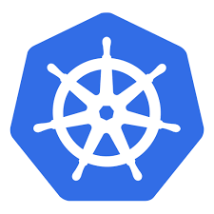
Kubernetes Cluster

Slide 9
Node
kublet
Docker

Slide 11


Slide 12
Agenda
Kubernetes Introduction
Kubernetes Concepts
Deploy Multi Microservices

Slide 13
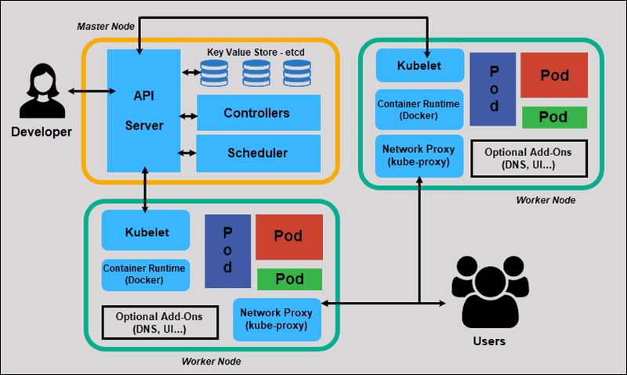
Kubernetes Components

Slide 14
Master Node
kube-apiserver
kube-ETCD
kube-Scheduler
kube-Controller-Manager

Slide 15
Master Components
kube-apiserver - exposes the Kubernetes API. It is the front-end for the Kubernetes control plane.
etcd - key value store used as Kubernetes’ backing store for all cluster data.
kube-scheduler - watches newly created pods that have no node assigned, and selects a node for them to run on.
kube-controller-manager –
Responsible for noticing and responding when nodes go down.
Responsible for maintaining the correct number of pods for every replication controller object in the system.
Populates the Endpoints object (that is, joins Services & Pods).

Slide 16
Master
Pod
Kube-apiserver
etcd
Kube-scheduler
Kube-controller-manager
kublet
containerd
kublet
containerd
Node
Node Processes
Kubernetes Cluster
kublet
containerd

Slide 17
Node Components
Kubelet - An agent that runs on each node in the cluster. It makes sure that containers are running in a pod.
Container Runtime - is the software that is responsible for running containers. Kubernetes supports some runtimes: containerd, CRI-O, Docker
kube-proxy - enables the Kubernetes service abstraction by maintaining network rules on the host and performing connection forwarding.

Slide 18
Addons (cluster components)
DNS - a DNS server, which serves DNS records for Kubernetes services
Web UI (Dashboard) - web-based UI for Kubernetes clusters
Container Resource Monitoring - records generic time-series metrics about containers in a central database, and provides a UI for browsing that data
Cluster-level Logging - responsible for saving container logs to a central log store with search/browsing interface.

Slide 19
POD
Represents a unit of deployment: a single instance of an application in Kubernetes, which might consist of either a single container or a small number of containers that are tightly coupled and that share resources.
10.97.14.200
my-pod.yaml
apiVersion: v1
kind: Pod
metadata:
name: static-web
labels:
role: myrole
spec:
containers:
- name: web
image: nginx
# Create a pod from a file.
$ kubectl apply –f my-pod.yaml

Slide 20
Deployment
my-deploy.yaml
apiVersion: apps/v1
kind: Deployment
metadata:
name: nginx-deployment
labels:
app: nginx
spec:
replicas: 3
selector:
matchLabels:
app: nginx
template:
metadata:
labels:
app: nginx
spec:
containers:
- name: my-app
image: nginx
A Deployment controller provides declarative updates for Pods and ReplicaSets
Using kubectl declarative command:
# Create a deployment from a file.
$ kubectl apply –f my-deploy.yaml

Slide 21
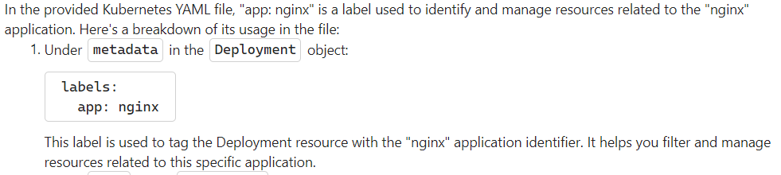
Deployment labels

Slide 22
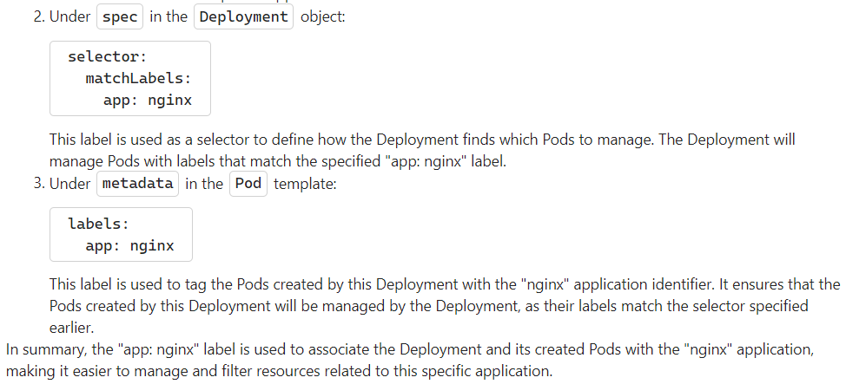
Deployment labels

Slide 23
Deployment labels

Slide 24

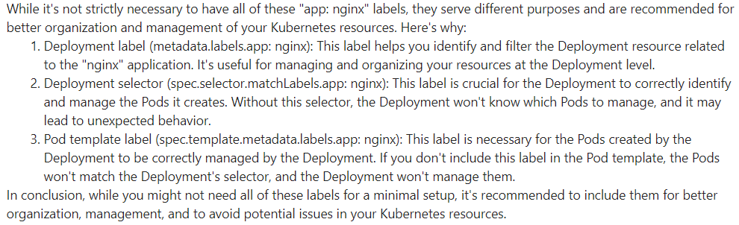
Deployment labels

Slide 25
Set Environment Variable to the Pod Container
spec:
containers:
- name: nginx
image: nginx:1.7.9
ports:
- containerPort: 80
env:
- name: DEMO_GREETING
value: "Hello from the environment"
Add to spec.containers.env list of desired environments variables
# Run command on pod container.
$ kubectl exec -it my-pod-name -- env | grep DEMO_GREETING

Slide 26

kubectl create -f my-deploy.yaml
D
Master
Node#3
Docker
kublet
Node#1
kublet
Docker
Node#2
Kubernetes Cluster
kublet
Docker

Slide 27
Service
A Service in Kubernetes is a REST object, meaning its definition can be POSTed to the apiserver to create a new instance.
This specification will create a new Service object named “my-service” which targets TCP port 80 on any Pod with the "app=MyApp" label.
my-service.yaml
kind: Service
apiVersion: v1
metadata:
name: my-service
spec:
selector:
app: nginx
ports:
- protocol: TCP
port: 8080
targetPort: 80
# Create a service from a file.
$ kubectl apply –f my-service.yaml

Slide 28
Endpoints
Once a Service object with selector is created, it will be assigned with virtual IP and – a corresponding Endpoints object is also created.
kind: Service apiVersion: v1 metadata: name: my-service spec:
clusterIP: 10.106.92.105
selector: app: MyApp ports: - protocol: TCP port: 8080 targetPort: 80
kind: Endpoints apiVersion: v1 metadata: name: my-service
labels:
app: MyApp
subsets: - addresses: - ip: 10.10.10.2
- addresses: - ip: 10.10.10.3
ports: - port: 80
10.10.10.2:80
my-app
kubelet
Dock
10.10.10.3:80
my-app
kubelet
Dock

Slide 29
IPTABLES rules – node port 23456 to <pod_ip>:80
# iptables -t nat -L PREROUTING
KUBE-SERVICES all -- anywhere anywhere /* kubernetes service portals */
# iptables -t nat -L KUBE-SERVICES
KUBE-NODEPORTS all -- anywhere anywhere /* kubernetes service nodeports; NOTE: this must be the last rule in this chain */ ADDRTYPE match dst-type LOCAL
# iptables -t nat -L KUBE-NODEPORTS
KUBE-SVC-BAR6BUTX5H2RXQHR tcp -- anywhere anywhere /* default/lc-web */ tcp dpt:23456
# iptables -t nat -L KUBE-SVC-BAR6BUTX5H2RXQHR
KUBE-SEP-V3I5ZMI6HNNKFTAG all -- anywhere anywhere /* default/lc-web */ statistic mode random probability 0.33333333349
KUBE-SEP-VCKZVZIZW7BZXXHP all -- anywhere anywhere /* default/lc-web */ statistic mode random probability 0.50000000000
KUBE-SEP-DL2DGDTYSOSGT7JL all -- anywhere anywhere /* default/lc-web */
# iptables -t nat -L KUBE-SEP-V3I5ZMI6HNNKFTAG
DNAT tcp -- anywhere anywhere /* default/lc-web */ tcp to:10.244.2.5:80
# kubectl get po -owide
c-web-6d5479f46-tpvhd 1/1 Running 0 34m 10.244.2.5 kind-worker2 <none> <none>
Resource : https://ronaknathani.com/blog/2020/07/kubernetes-nodeport-and-iptables-rules/

Slide 30
kube-apiserver notifies kube-proxy on every Node on new Service and Endpoints Objects:
kube-apiserver
kubelet
Dock
kubelet
Dock
10.10.10.2:80
my-app
kube-proxy
Iptables for service (with virtual ip) and endpoints
-A KUBE-SEP-57K ...
-A KUBE-SEP-5RZ ….
-A KUBE-SERVICES ….
-A KUBE-SVC-NW ...
-A KUBE-SVC-NV5 ….
kubelet
Docker

Slide 31
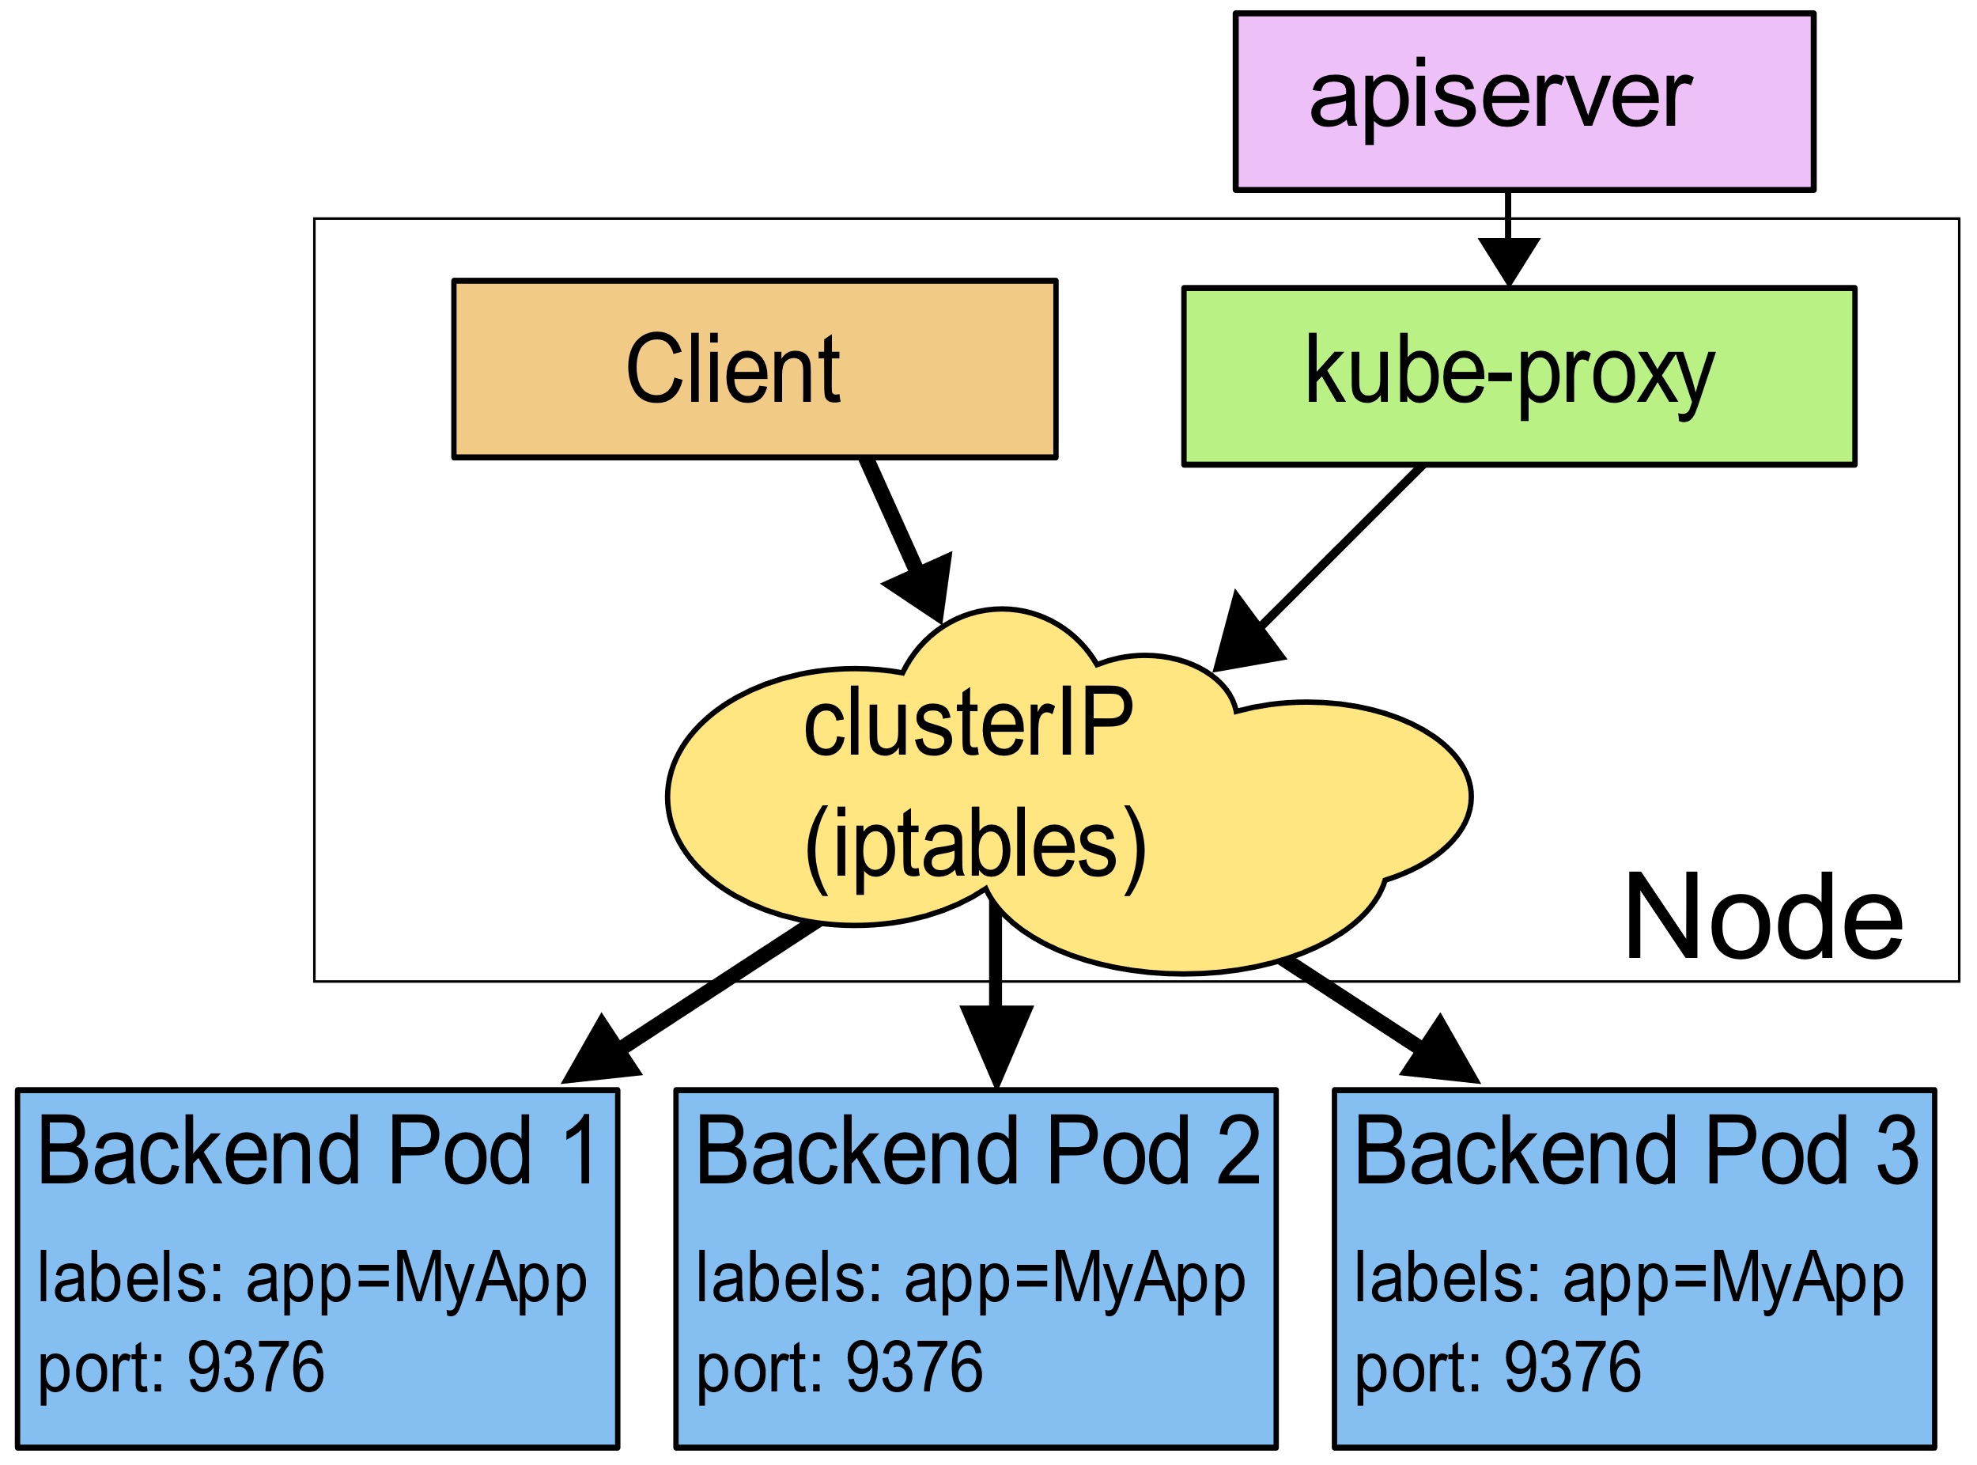
kube-apiserver notifies kube-proxy on every Node on new Service and Endpoints Objects:

Slide 32
Discovering Services – kube-dns
The DNS server watches the Kubernetes API for new Services and creates a set of DNS records for each.
If DNS has been enabled throughout the cluster then all Pods should be able to do name resolution of Services automatically.

Slide 33

kubectl
172.18.0.3:30123
172.18.0.4:30123
app=lc-web
lc-web
10.42.0.1:80
10.38.0.4:80
172.18.0.2:30123
service
10.42.0.2:80
app=lc-web
Kubernetes Cluster
10.38.0.4:80
service

Slide 34
Working with kubectl Declerative Commands
Rolling-Update your Application (Lab: task-3)
# Create or update resource as declared in the file
$ kubectl apply -f web-deploy.yaml
# List all services
$ kubectl get svc
# List pods and show all labels as the last column
$ kubectl get po --show-labels
# Rollback to previous resource revision
$ kubectl rollout undo deployment deploy-name

Slide 35
Agenda
Kubernetes Introduction
Kubernetes Concepts
Deploy Multi Microservices

Slide 36

web-service :80
(Lab: task-4)
Lets-Chat-Web
(Nginx)
Lets-Chat-Web
(Nginx)
Lets-Chat-Web
(Nginx)
app-service :8080
Lets-Chat-App
(Node.js)
db-service :27017
Lets-Chat-DB
(MongoDB)

Slide 37
kubectl
10.30.0.2:8080
10.40.0.2:80
app=lc-app
app=lc-web
lc-web
10.42.0.1:80
app=lc-web
lc-app
lc-db
Master
Services
Services
Node#3
Docker
kublet
Node#1
kublet
Services
Docker
10.32.0.3:27017
10.43.0.2:80
app=lc-db
app=lc-web
Node#2
Kubernetes Cluster
kublet
Docker

